Slide 1
Identifying Gifted and Talented Students

Slide 2
Who are our Gifted and Talented students?
Gagne: Students who’s potential is distinctively above average
intellectually
creatively
socially
Physically
Our environment, parents and schooling influence us to develop a gift into a talent.
Tannenbaum identifies five factors that influence this conversion:
superior general intellect
distinctive special aptitudes
a supportive array of non-intellective traits such as personality, self-concept or motivation
a challenging and facilitative environment
Chance
Ranzuli identifies three basic clusters of human traits:
above-average general ability
high levels of creativity
high levels of task commitment.

Slide 3
How do we identify students:
Tests: AGAT test has three components:
Abstract reasoning: We test students ability to recognize patterns, non verbal reasoning skills and working accurately at speed
Verbal: We test student’s word knowledge and ability to see relationships in concepts
Mathematical: We test student’s number sense and ability to work accurately at speed
PAT tests: We monitor student growth over time.
Teacher nomination: * Related to test data
* Teacher feeling that a student is underachieving and needs extension

Slide 4
Is curious and investigative
Asks penetrating questions
Will investigate independently if a topic is of interest
Has a large vocabulary
Shows imagination, originality, creativity
Learns very quick,
Remembers things that are said or read easily
Does not need much repetition
Easily bored with routine tasks
Can be assertive and stubborn about own ideas
Thinks clearly
Recognises implied relationships
Comprehends meaning easily
Learns complex concepts easily but makes mistakes in easy tasks
Has a long attention span
Prefers complex ideas
Has excellent problem solving skills
Prefers complex ideas

Slide 5
Characteristics of Gifted and Talented students
Poor organizational skills
Poor work habits
Lack of common sense
Can be bored and stop paying attention
Looks to be dreaming but is thinking
Students have many ideas, but can’t prioritise
Can be talented in one aspect of learning only
Can be the class clown
Can be overly emotional
Very sensitive towards emotions of others
Poor social skills
Doesn’t try because he wants to fit in
Low self esteem

Slide 6
How can you support your child
Support their abilities:
Allow your child to read well above age level but still do bed time reading. Discuss books at a more abstract level. Ie friendships, right and wrong etc.
Read the book yourself first
Offer games that are well above age level
Use more complicated language in conversations
Allow them to find out about ideas, let them read adult non-fiction books or use websites like National Geographic

Slide 7
Teach organisation skills
Help your child to remember by setting up routines
Organisation skills influence organizing games, making things, writing a text and doing research. Help your child to order actions logically
Use strategies to be organised. Have a homework folder and develop the routine to put homework back in the folder and schoolbag.
Don’t have too many items in a pencil case.
Don’t do things for your child but support them by asking what they should be doing.
Make lists and prepare the night before

Slide 8
Learns complex concepts easily but makes mistakes in easy tasks
Emphasize the importance of the easy tasks
How can repetitive work be made more fun practice your times tables with an online Maths trainer
Use real life examples to explain that abstract concepts are important

Slide 9
What does it mean to be gifted and talented?
What kind of smart do we use in schooling and work?
Memory
Being good writers/ speakers
Excellent mathematicians
Higher order thinking
Being able to grasp concepts quickly
Being ably to connect concepts and facts from different learning areas (implied relationships)
Which skills do we require when completing a university degree or to be an inventor?

Slide 10
Lack of commonsense and poor social skills
Being able to understand complex concepts does not relate to having common sense
This relates to having poor social skills. Some G&T children find it difficult to predict what someone else wants them to do
G&T children often have many ideas at once and concentrate more on complex ideas, forgetting easy solutions and commonsense
They are sometimes our quirky kids. Their thinking is far more mature than their peers which makes social interaction tricky
Sometimes they make other children feel inferior.
Being smart is not about being better it is about being different.

Slide 11
Students have many ideas and can’t prioritise or complete a task
Support your child to complete a task or game. They can get bored quickly
Sometimes they use this to avoid doing complicated tasks

Slide 12
Poor work habits
G&T students sometimes know what the teacher is going to teach before they start
This results in poor work habits
Students don’t have to try and don’t learn to make mistakes and fail
They get high marks without doing homework and without trying
This results in not developing those skills

Slide 13
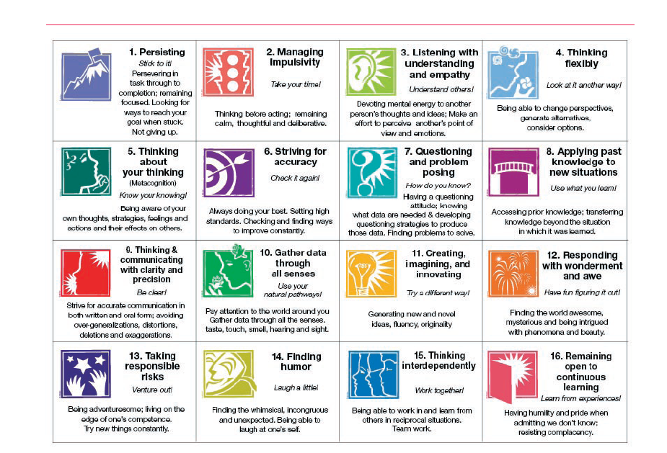
•
•Respects varied perspective
•Shows open-mindedness
•Is effective in evaluating own quality of work
•Seeks quality more than comfort and ease
•Thinks before acting
•Strives for accuracy
•Asks important questions
•Shows appreciation/awe/wonder with

Slide 14
Language
Literacy year 6: Literary circles incudes higher order thinking strategies
Visual literacy year 5: Students are making their own picture books
Animation year 4: Students learn script writing skills whilst making their own animation

Slide 15
Maths
Mathematical thinking skills:
The ages of the three children in the Jones Family add up to 14. If their ages are multiplied together, the result is 70. What is the age of the eldest child?
Hands on Maths:
Origami
Fibonacci sequence
Escher tesselations
Euler formula

Slide 16
Imagineers program
Solar car challenge
Robotics
Science in Art
Sustainability Dying with plant materials
Business studies
Forensics
Astronomy
Executive functioning skills
Going for gold (learning about gold and geology
Engineering
Tournament Of Minds

Slide 17
Homework
Students will be given work to prepare for Imagineers
For Language they might be asked to read the next chapter for next class
For Maths they will be asked to try the next sum. If the problem is too difficult, try it and we will problem solve in class as well
They might be able to do some in class
They should not exceed their allocated homework time
Giving students some homework helps them to develop organization skills

